Slide 1
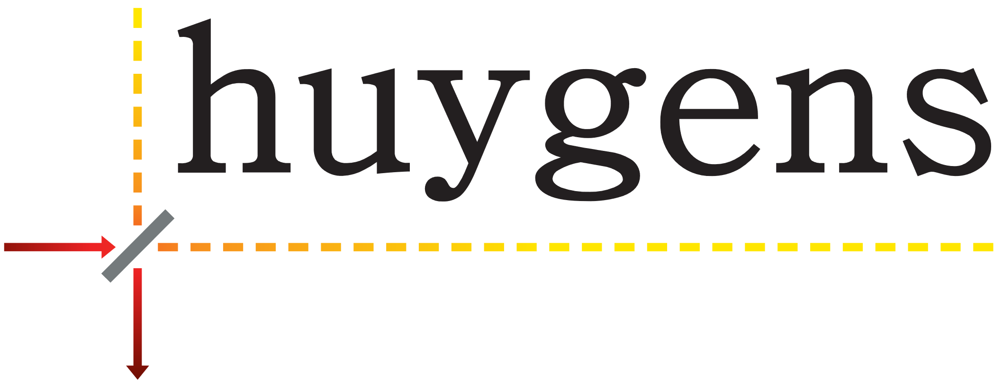
Effect of Evolocumab on Changes in Coronary Plaque Phenotype and Burden in Statin-Treated Patients Following Myocardial Infarction: The HUYGENS Randomized Clinical Trial
Stephen J Nicholls, MBBS, PhD,^{1,}* Yu Kataoka, MD, PhD,^{2,}* Steven E Nissen, MD,³ Francesco Prati, MD,⁴ Stephan Windecker, MD,⁵ Rishi Puri, MBBS, PhD,³ Thomas Hucko, MD,⁶ Daniel Aradi, MD , PhD⁷⁻⁹ Jean-Paul R Herrman, MD, PhD,¹⁰ Renicus S Hermanides, MD, PhD,¹¹ Bei Wang, PhD,⁶ Huei Wang, PhD,⁶ Julie Butters, BHSc, MBA,¹ Giuseppe Di Giovanni, BSc (Hons),¹² Stephen Jones, BAppSc, BHSc (Hons),¹² Gianluca Pompili, BSc, BA,¹² and Peter J Psaltis, MBBS, PhD^{12,13}
¹Victorian Heart Institute, Monash University, Clayton, Australia, ²Department of Cardiovascular Medicine, National Cerebral and Cardiovascular Centre, Suita, Japan, ³Heart and Vascular Institute, Cleveland Clinic, Cleveland, OH, USA, ⁴San Giovanni Hospital; UniCamillus “Saint Camillus International University of Health Science”, Rome, Italy, ⁵Department of Cardiology, Inselspital, Bern University Hospital, University of Bern, Switzerland, ⁶Global Development, Amgen Inc., Thousand Oaks, CA, USA, ⁷Heart and Vascular Center, University of Semmelweis, Hungary, ⁸Heart Center Balatonfüred, Hungary, ⁹Tagore Medical Center, Balatonfüred, Hungary, ¹⁰OLVG Oost, Amsterdam, The Netherlands, ¹¹Isala Hospital, Zwolle, Department of Cardiology, The Netherlands, ¹²South Australian Health and Medical Research Institute, Adelaide, Australia, ¹³Adelaide Medical School, University of Adelaide; Department of Cardiology, Central Adelaide Local Health Network, Adelaide, Australia.
*Contributed equally to this project
SC-AT-AMG145-01183 0724
Date of Preparation: March 2022

Slide 2
Introduction
Intensive statin therapy alone or in combination with ezetimibe and/or PCSK9 inhibitors has demonstrated incremental benefits in lowering LDL-C¹⁻⁴
Most acute episodes of ACS result from rupturing of an atherosclerotic plaque that is enriched with lipid and inflammatory material and covered by a fibrous cap < 65 μm in thickness^{5,6}
Patients with more recent MIs and with residual multivessel disease may benefit more by the addition of a PCSK9 inhibitor to statin therapy⁷
While clinical trials suggest that statins increase plaque FCT, the effect of PCSK9 inhibition on plaque phenotype using serial OCT has not been evaluated⁸
HUYGENS was designed to assess whether PCSK9 inhibition in addition to high-intensity statin therapy favorably modifies coronary plaque phenotype⁹
ACS, acute coronary syndrome; FCT, fibrous cap thickness; HUYGENS, High-Resolution Assessment of Coronary Plaques in a Global Evolocumab Randomized Study; LDL-C, low-density lipoprotein cholesterol; MI, myocardial infarction; OCT, optical coherence tomography; PCSK9, proprotein convertase subtilisin/kexin type 9.
1. Cannon CP, et al. N Engl J Med. 2004;350:1495-1504. 2. Cannon CP, et al. N Engl J Med. 2015;372:2387-2397. 3. Schwartz GG, et al. N Engl J Med. 2018;379:2097-2107.
4. Sabatine MS, et al. N Engl J Med. 2017;376:1713-1722. 5. Burke AP, et al. N Engl J Med. 1997;336:1276-1282. 6. Virmani R, et al. J Am Coll Cardiol. 2006;47:C13-C18.
7. Sabatine MS, et al. Circulation. 2018;138:756-766. 8. Komukai K, et al. J Am Coll Cardiol. 2014;64:2207-2217. 9. Nicholls SJ, et al. [published online ahead of print March 16, 2022]. JACC Cardiovasc Imaging. doi:10.1016/j.jcmg.2022.03.002.

Slide 3











Continuum of Coronary Atherosclerosis
Asymptomatic/subclinical disease
Clinically overt disease
Intimal layer
thickens
Fatty streak
develops
Lipids accumulate, atheroma grows
Atherosclerotic
plaque
Vulnerable
plaque
Calcified nodules
develop
Fibrocalcific
plaque
Plaque erosion/rupture
Thrombosis
Stenosis
Unstable angina/
myocardial infarction
Stable angina
Plaques can remain asymptomatic or become obstructive enough to cause stable angina. Some plaque may become vulnerable and rupture, eliciting acute thrombosis, which may lead to an ACS.
ACS, acute coronary syndrome.
Sandfort V, et al. Circ Cardiovasc Imaging. 2015;8:e003316.

Slide 4
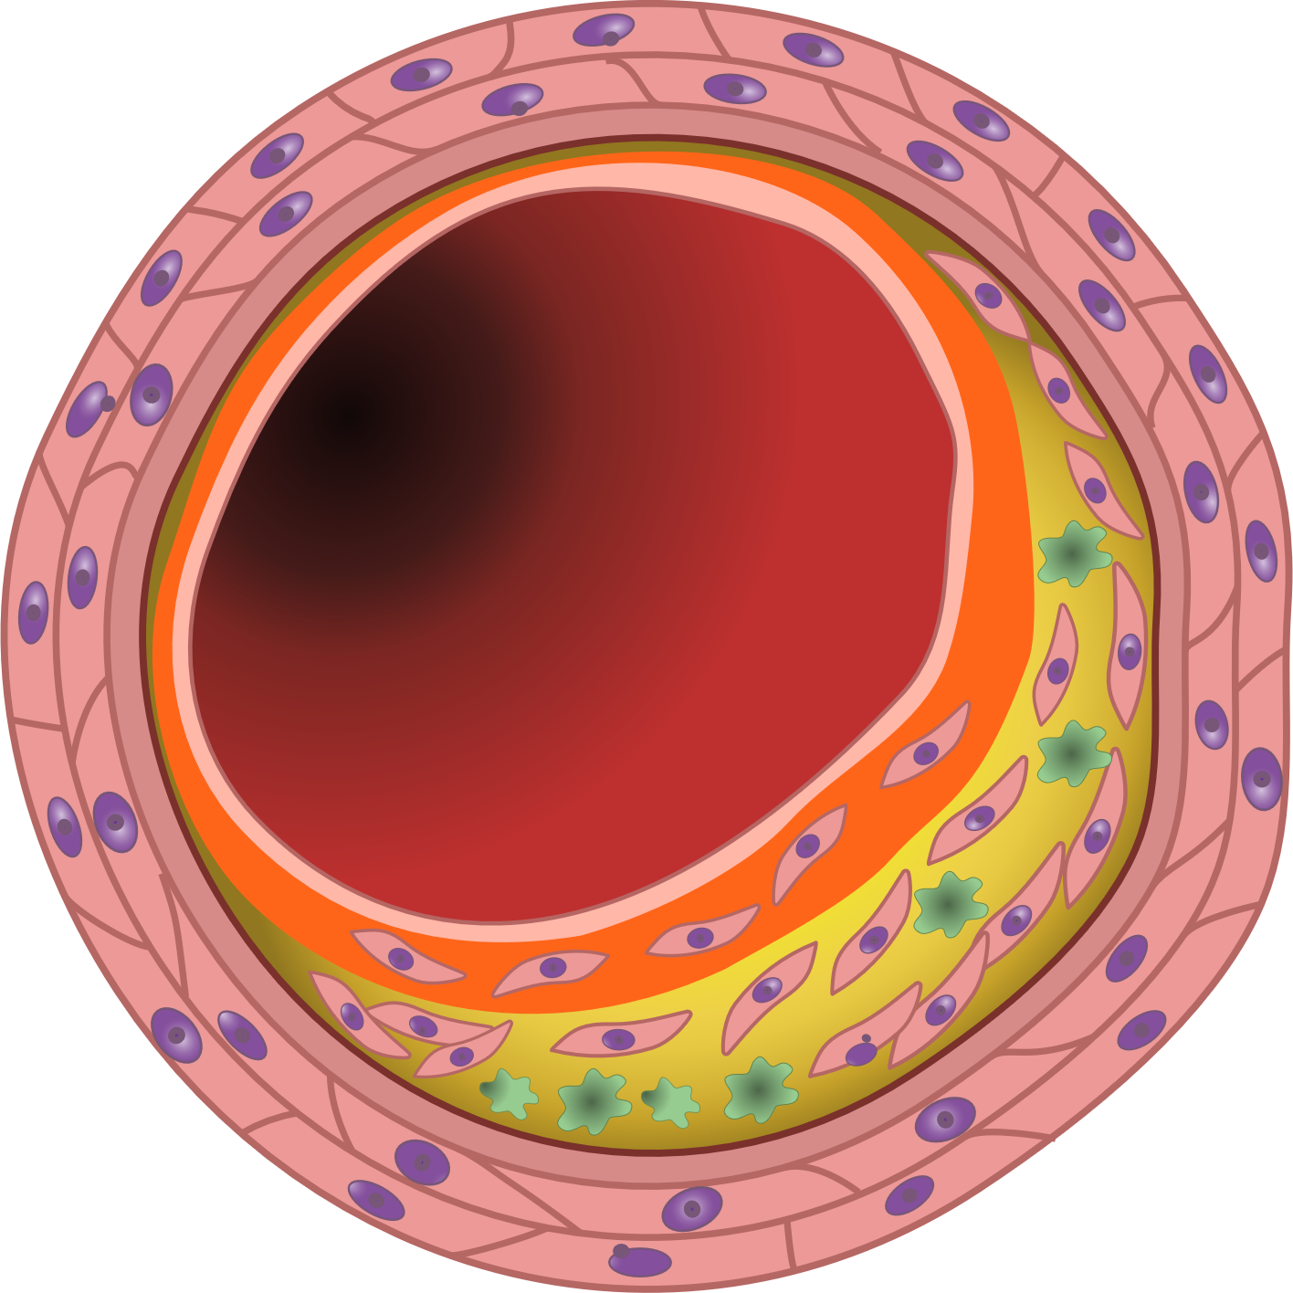
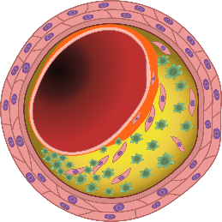
What Are the Key Features of a Vulnerable Plaque?
Lumen
Stable Plaque¹
Vulnerable Plaque^{1,2}
Small lipid core
Thick fibrous cap
Smooth muscle cells
Large lipid core
Thin fibrous cap
Macrophages
Smooth muscle cell
Lipid-rich core
Thick fibrous cap
Macrophage
Thin fibrous cap
Vulnerable plaque features can be visualized using OCT, which offers
a high-resolution imaging necessary to detect characteristics of vulnerable plaque with high sensitivity.³
Generally, vulnerable plaques are characterized by a thin fibrous cap (< 65 µm),
large lipid core (lipid arc > 90º), and presence of inflammatory cells.^{1,2}
OCT, optical coherence tomography.
1. Virmani R, et al. Arterioscler Thromb Vasc Biol. 2000;20:1262-1275. 2. Stefanidis C, et al. J Am Heart Assoc. 2017;6:e005543.
3. MacNeill BD, et al. Arterioscler Thromb Vasc Biol. 2003;23:1333-1342.

Slide 5
HUYGENS: High-Resolution Assessment of Coronary Plaques in a Global Evolocumab Randomized Study^{1,2}
Evolocumab 420 mg
(SC) monthly
Aim: To evaluate the impact of PCSK9 inhibition with evolocumab on coronary atheroma phenotype post-ACS^{1,2}
Inclusion Criteria^{1,2}
Study Design²
NSTEMI
Angiographic CAD
LDL-C ≥ 60 mg/dL on high-intensity statin, ≥ 80 mg/dL on low-/moderate-intensity statin, or ≥ 130 mg/dL on no statin at screening
Subsequently treated with maximally tolerated statin
At least one OCT image with an FCT
≤ 120 µm and one image with lipid arc
> 90° in a segment ≥ 40 mm in lengthª
Screening
(Coronary angiogram;
baseline OCT/IVUS;
SC injection 3 ml placebo)
Randomization 1:1
Placebo (SC) monthly
End of study
OCT/IVUS
Last dose of
study drug
End of study visit
Maximum 7 days
Day 1
Week 48
Week 50
Week 52
Primary Endpoint¹
Secondary Endpoints¹
Nominal change in minimum FCT in a matched arterial segment from baseline to week 50
Percent change in minimum FCT
Absolute change in the average of the minimum FCT for all images
Absolute change in the maximum lipid arc
A prespecified additional analysis determined the absolute change in minimum FCT, maximum lipid arc, and lipid core length in lipid-rich atheroma regions. Exploratory analyses included plaque burden by IVUS (PAV and TAV) and lipid parameters, to determine their relationship with changes in OCT parameters, and the presence of plaque microchannels, macrophages, and calcium.¹
ªIn a vessel other than where the culprit lesion was present.¹
This trial was not designed to assess a correlation between changes in FCT and cardiovascular events.
ACS, acute coronary syndrome; CAD, coronary artery disease; FCT, fibrous cap thickness; IVUS, intravascular ultrasound; LDL-C, low-density lipoprotein cholesterol; NSTEMI, non–ST elevation myocardial infarction; OCT, optical coherence tomography; PAV, percent atheroma volume; PCSK9, proprotein convertase subtilisin/kexin type 9; SC, subcutaneous; TAV, total atheroma volume.
1. Nicholls SJ, et al. [published online ahead of print March 16, 2022]. JACC Cardiovasc Imaging. doi:10.1016/j.jcmg.2022.03.002.
2. Nicholls SJ, et al. Cardiovasc Diagn Ther. 2021;11:120-129.

Slide 6
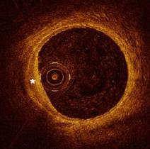
HUYGENS: OCT and IVUS Imaging
Following coronary angiography, baseline OCT and IVUS imaging were conducted¹
Imaging was performed in a single, nonculprit artery; the artery was required to have no stenosis > 50%, but was not required to have a stenosis > 20% if one was present elsewhere in the coronary tree¹
The measurements made by an analyst were reviewed by another member of the core laboratory and a medical reviewer¹
At week 50, patients underwent a second OCT and IVUS examination within the same artery¹
Analysis of OCT cross-sectional images, spaced 0.2 mm apart, was performed¹
  Where lipidic plaque was present, minimum FCT, lipid arc, presence of macrophages, and calcium accumulation were measured
  IVUS cross-sectional images underwent measurements of the lumen and external elastic membrane within the same segment employed for OCT analysis, for subsequent analyses of the relationship between changes in plaque burden and phenotype
  Where evaluable, IVUS imaging was present at both time points within the same matched arterial segment employed for OCT analysis, and PAV and TAV were measured
Artery lumen
Catheter
Image courtesy of van Ditzhuijzen NS, et al. Neth Heart J. 2011;19:442-446²
This trial was not designed to assess a correlation between changes in FCT and cardiovascular events.
FCT, fibrous cap thickness; IVUS, intravascular ultrasound; OCT, optical coherence tomography; PAV, percent atheroma volume; TAV, total atheroma volume.
1. Nicholls SJ, et al. [published online ahead of print March 16, 2022]. JACC Cardiovasc Imaging. doi:10.1016/j.jcmg.2022.03.002. 2. van Ditzhuijzen NS, et al. Neth Heart J. 2011;19:442-446.

Slide 7
HUYGENS: Baseline Characteristics and OCT Measures Were Balanced Between Groups
Baseline Demographics and Statin Usage^{1,2}
Baseline OCT Measures¹
 | Placebo (n = 81) | Evolocumab (n = 80)
Age (mean) | 60.2 | 60.9
Male gender (%) | 67.9 | 75.0
Prior statin use > 4 weeks (%)ª | 24.4 | 23.2
Baseline statin use (%) | 96.3 | 93.8
High intensity statin use (%) | 82.7 | 78.8
 | Placebo (n = 81) | Evolocumab (n = 80)
Minimum FCT (μm) | 54.6 | 56.6
Average minimum FCT (μm) | 133.6 | 142.3
Maximum lipid arc (º) | 224.8 | 230.2
FCT < 65 μm (%) | 71.6 | 77.5
LDL-C (mg/dL)^{b} | 142.1 | 140.4
ªAt screening. ^{b}When the calculated LDL-C is < 40 mg/dL or triglycerides are > 400 mg/dL, ultracentrifugation LDL-C was determined from the same blood sample.¹
This trial was not designed to assess a correlation between changes in FCT and cardiovascular events.
FCT, fibrous cap thickness; LDL-C, low-density lipoprotein cholesterol; OCT, optical coherence tomography.
1. Nicholls SJ, et al. [published online ahead of print March 16, 2022]. JACC Cardiovasc Imaging. doi:10.1016/j.jcmg.2022.03.002.
2. Nicholls SJ, et al. Slides presented at: European Society of Cardiology Congress; August 27-30, 2021; Digital Congress.

Slide 8
Evolocumab Improved Features of Plaque Stability Compared With Placebo
HUYGENS Primary Endpoint: Minimum FCT¹
HUYGENS Secondary Endpoint: Maximum Lipid Arc¹
–20
LS mean change in FCT (μm)
+42.7
LS mean change in
lipid arc (°)
–31.4
P = 0.015
–40
P = 0.04
+21.5
–57.5
–60
(n = 81)
(n = 80)
(n = 81)
(n = 80)
Baseline FCT:
54.6 μm
56.6 μm
Baseline max lipid arc:
224.8°
230.2°
At the end of the study, only 12.5% of patients in the evolocumab group had at least one image with a minimum FCT < 65 μm, compared with 30.2% of patients in the placebo group; between-group difference P = 0.02 (exploratory endpoint).¹
Addition of evolocumab to intensive statin therapy nearly doubled the absolute change in minimum FCT and greatly reduced maximum lipid arc compared with maximally tolerated statin therapy alone.¹
FCT is described as the signal-rich region between the lumen and signal-poor necrotic lipid core in OCT; FCT < 65 µm suggests a thin fibrous cap associated with vulnerable plaque.^{2,3} Lipid arc is described as the widest arc demarcating a signal-poor region with diffuse borders in OCT. A wide lipid arc (> 90º) suggests increased lipid content.² The primary and secondary endpoints were analyzed using ANCOVA.⁴
This trial was not designed to assess a correlation between changes in FCT and cardiovascular events.
ANCOVA, analysis of covariance; FCT, fibrous cap thickness; LS, least squares; OCT, optical coherence tomography.
1. Nicholls SJ, et al. [published online ahead of print March 16, 2022]. JACC Cardiovasc Imaging. doi:10.1016/j.jcmg.2022.03.002. 2. Stefanidis C, et al. J Am Heart Assoc. 2017;6:e005543.
3. Komukai K, et al. J Am Coll Cardiol. 2014;64:2207-2217. 4. Nicholls SJ, et al. Cardiovasc Diagn Ther. 2021;11:120-129.

Slide 9
Evolocumab Improved Features of Plaque Stability Compared With Placebo
HUYGENS Secondary Endpoint:
Percentage Change in Minimum FCT¹
HUYGENS Secondary Endpoint:
Average Minimum FCT for All Images¹
+81.8
62.3
LS mean change in FCT %
P = 0.04
LS mean change
in FCT (μm)
P = 0.02
+44.3
29.8
(n = 81)
(n = 80)
(n = 81)
(n = 80)
Baseline FCT:
54.6 μm
56.6 μm
Baseline average minimum FCT:
133.6 µm
142.3 µm
Addition of evolocumab to intensive statin therapy nearly doubled the LS mean percentage change in minimum FCT as well as the average minimum FCT for all images compared with maximally tolerated statin therapy alone.¹
The primary and secondary endpoints were analyzed using ANCOVA.²
This trial was not designed to assess a correlation between changes in FCT and cardiovascular events.
ANCOVA, analysis of covariance; FCT, fibrous cap thickness; LS, least squares.
1. Nicholls SJ, et al. [published online ahead of print March 16, 2022]. JACC Cardiovasc Imaging. doi:10.1016/j.jcmg.2022.03.002.
2. Nicholls SJ, et al. Cardiovasc Diagn Ther. 2021;11:120-129.

Slide 10
The Degree of FCT Increase Was Related to the Intensity of Lipid Lowering Observed
LDL-C¹
Change in Min FCT vs Achieved LDL-C¹
80
P < 0.001
P < 0.001
60
Absolute change in min FCT (µm)
40
20
LDL-C (mg/dL)
0
10
20
30
40
50
60
70
80
90
100
110
Achieved LDL-C (mg/dL)
Change in Min FCT vs Change in LDL-C¹
70
60
Baseline
Follow-up
Baseline
Follow-up
50
Absolute change in min FCT (µm)
Placebo (n = 81)
Evolocumab (n = 80)
40
30
20
–200
–180
–160
–140
–120
–100
–80
–60
–40
–20
0
Change in LDL-C (mg/dL)
LDL-C was reduced by 80% in the evolocumab group, compared with 39% in patients on maximally tolerated statins alone. A correlation between achieved LDL-C and change in minimum FCT was shown.¹
The primary and secondary endpoints were analyzed using ANCOVA.²
This trial was not designed to assess a correlation between changes in FCT and cardiovascular events.
ANCOVA, analysis of covariance; FCT, fibrous cap thickness; LDL-C, low-density lipoprotein cholesterol.
1. Nicholls SJ, et al. [published online ahead of print March 16, 2022]. JACC Cardiovasc Imaging. doi:10.1016/j.jcmg.2022.03.002.
2. Nicholls SJ, et al. Cardiovasc Diagn Ther. 2021;11:120-129.

Slide 11
Larger Changes in Minimum FCT and Maximum Lipid Arc Within the Lipid-Rich Plaque Regions Were Observed in the Evolocumab Groups vs the Placebo Group
Lipid-Rich Plaque Region Endpoint on OCT:
Minimum FCT¹
Lipid-Rich Plaque Region Endpoint on OCT:
Maximum Lipid Arc (°)¹
–10
Median change in FCTª (μm)
Median change in FCTª (μm)
–25.0
P = 0.04
39.0
–30
P = 0.02
–52.0
24.0
–50
–70
(n = 81)
(n = 80)
(n = 81)
(n = 80)
Baseline minimum FCT:
52.2 μm
53.7 μm
Baseline maximum lipid arc:
229.9°
238.1°
Addition of evolocumab to statins resulted in significant change in the minimum FCT as well as in the maximum lipid arc within the lipid-rich plaque regions than background statins alone.¹
Lipid-rich plaque is described as plaques with a presence of a minimum FCT < 120 µm and a lipid arc > 90° on at least three consecutive images in OCT.¹
The primary and secondary endpoints were analyzed using ANCOVA.²
ªValue for patients who had follow-up OCT imaging within the prespecified imaging window of week 48–52 (n = 110).¹
ANCOVA, analysis of covariance; FCT, fibrous cap thickness; OCT, optical coherence tomography.
1. Nicholls SJ, et al. [published online ahead of print March 16, 2022]. JACC Cardiovasc Imaging. doi:10.1016/j.jcmg.2022.03.002.
2. Nicholls SJ, et al. Cardiovasc Diagn Ther. 2021;11:120-129.

Slide 12
Evolocumab Treatment Was Associated With Further Benefits
Within the Lipid-Rich Plaque Regions
Lipid-Rich Plaque Region Endpoint on OCT: Lipid Length¹
Evolocumab treatment in combination with background statins was associated with a significantly larger reduction in macrophage index:¹
  LS mean (n = 135) of –3.17 mm compared with
  –1.45 mm with statins alone (P = 0.04)
Median change in lipid length (mm)ª
–5
–3.4
P = 0.02
–5.2
–10
(n = 81)
(n = 80)
Baseline lipid length:
14.0
15.0
Addition of evolocumab to statins results in greater reduction in lipid core length within the lipid-rich plaque regions and macrophage index, than background statins alone.¹
Lipid length is usually measured by detection of sequential OCT frames within a lipid plaque segment, defined as a diffusely bordered signal-poor region with high attenuation by the signal-rich region covering them.² The primary and secondary endpoints were analyzed using ANCOVA.³
ªValue for patients who had follow-up OCT imaging within the prespecified imaging window of week 48–52 (n = 110).¹
ANCOVA, analysis of covariance; LS, least squares; OCT, optical coherence tomography.
1. Nicholls SJ, et al. [published online ahead of print March 16, 2022]. JACC Cardiovasc Imaging. doi:10.1016/j.jcmg.2022.03.002.
2. Gnanadesigan M, et al. Int J Cardiovasc Imaging. 2017;33:5-11. 3. Nicholls SJ, et al. Cardiovasc Diagn Ther. 2021;11:120-129.

Slide 13
Exploratory Analysis by IVUS: Plaque Volume Changes With the Addition of Evolocumab to Background Statin Treatment
IVUS Assessment of Plaque Burden: Regression in PAV¹
IVUS Assessment of Plaque Burden: Regression in TAV¹
LS mean change in percent atheroma volume (%)
LS mean change in TAV (mm³)
–1
–0.6
–8.9
P = 0.009
–2.3
P = 0.04
–3
–20
–19.0
(n = 39)ª
(n = 40)ª
(n = 39)ª
(n = 40)ª
Baseline PAV:
45.1%
45.8%
Baseline PAV:
244.7 mm³
244.3 mm³
Percentage of patients with any decrease in PAV from baseline: 56.4% in the placebo group and 77.5% in the evolocumab group (P = 0.04)¹
Percentage of patients with any decrease in TAV from baseline: 66.7% in the placebo group and 80.0% in the evolocumab group (P = 0.18)¹
Addition of evolocumab demonstrated greater reduction in PAV and TAV compared with placebo.¹
The primary and secondary endpoints were analyzed using ANCOVA.²
ªNumber of subjects with observed data at both baseline and follow-up.¹
ANCOVA, analysis of covariance; IVUS, intravascular ultrasound; LS, least squares; NSTEMI, non–ST elevation myocardial infarction; PAV, percent atheroma volume;
TAV, total atheroma volume.
1. Nicholls SJ, et al. [published online ahead of print March 16, 2022]. JACC Cardiovasc Imaging. doi:10.1016/j.jcmg.2022.03.002.
2. Nicholls SJ, et al. Cardiovasc Diagn Ther. 2021;11:120-129.

Slide 14
Addition of Evolocumab Demonstrated a Safety Profile Comparable to
Maximally Tolerated Statin Alone in the Post-ACS Setting¹
Event | Placebo (n = 81) | Evolocumab (n = 80)
Death (%) | 1.2 | 0
Nonfatal MI (%) | 3.7 | 0
Injection-site reactions (%) | 1.2 | 0
Myalgia (%) | 7.4 | 6.3
Discontinuation from treatment (%) | 12.2 | 4.9
The most common AE was myalgia, which was not significantly different from the placebo group.
More patients in the placebo group discontinued treatment compared with the evolocumab group.^{1,2}
This trial was not designed to assess a correlation between changes in FCT and cardiovascular events.
ACS, acute coronary syndrome; AE, adverse event; FCT, fibrous cap thickness; MI, myocardial infarction.
1. Nicholls SJ, et al. [published online ahead of print March 16, 2022]. JACC Cardiovasc Imaging. doi:10.1016/j.jcmg.2022.03.002.
2. Nicholls SJ, et al. [published online ahead of print March 16, 2022]. JACC Cardiovasc Imaging. doi:10.1016/j.jcmg.2022.03.002; supplementary material.

Slide 15
Conclusions
HUYGENS demonstrated that the combination of evolocumab and statin therapy after an NSTEMI produces favorable changes in coronary atherosclerosis, consistent with stabilization and regression
Role of intensive lipid lowering is supported by observations of a direct relationship between the degree of LDL-C lowering or achieved LDL-C levels and increasing FCT
Early administration of a PCSK9 inhibitor was well tolerated and demonstrated a potential mechanism for the improved clinical outcomes in patients who achieve very low LDL-C levels following an ACS
ACS, acute coronary syndrome; FCT, fibrous cap thickness; LDL-C, low-density lipoprotein cholesterol; NSTEMI, non–ST elevation myocardial infarction; PCSK9, proprotein convertase subtilisin/kexin type 9.
Nicholls SJ, et al. [published online ahead of print March 16, 2022]. JACC Cardiovasc Imaging. doi:10.1016/j.jcmg.2022.03.002.

